Slide 1

Statistics for environmental science
SPEA-E538
Fall 2023
10/26/2023
Intro to ANOVA

Slide 2

Today’s agenda
ANOVA Concepts
One-factor between-subjects example

Slide 3
One-Factor ANOVA
Between-subjects designs

Slide 4
Overview
ANOVA concepts
one-factor between subjects example

Slide 5
ANOVA
ANOVA stands for ANalysis Of VAriance

Slide 6
Purpose of ANOVA
Statistical inference test for multiple (2 or more) groups
The kind of ANOVA you run depends on the experimental design. This week we focus on Between-Subjects designs

Slide 7
Heads up
The end result of an ANOVA gives back similar information as a t-test
t(df) = t-value, p = p-value
F(df1, df2) = F-value, p = value
Reporting of F-tests also typically include one more thing:
F(df1, df2) = F-value, MSE = MS error value, p = value

Slide 8
Fast Example
A <- c(20,11,2) B <- c(6,2,7) C <- c(2,11,2) IV <- as.factor(rep(c("A","B","C"),each=3)) DV <- c(A,B,C) df <- data.frame(IV,DV)

Slide 9
R: aov()
aov(DV~IV,df)
## Call: ## aov(formula = DV ~ IV, data = df) ## ## Terms: ## IV Residuals ## Sum of Squares 72 230 ## Deg. of Freedom 2 6 ## ## Residual standard error: 6.191392 ## Estimated effects may be unbalanced

Slide 10
R: summary()
The summary() function provides the ANOVA table
aov_results <- aov(DV~IV,df) summary(aov_results)
## Df Sum Sq Mean Sq F value Pr(>F) ## IV 2 72 36.00 0.939 0.442 ## Residuals 6 230 38.33

Slide 11
Things we need to understand
The logic of the ANOVA
What each part of the ANOVA table tells us
Let’s start by looking at the example for the next lab on ANOVA.

Slide 12
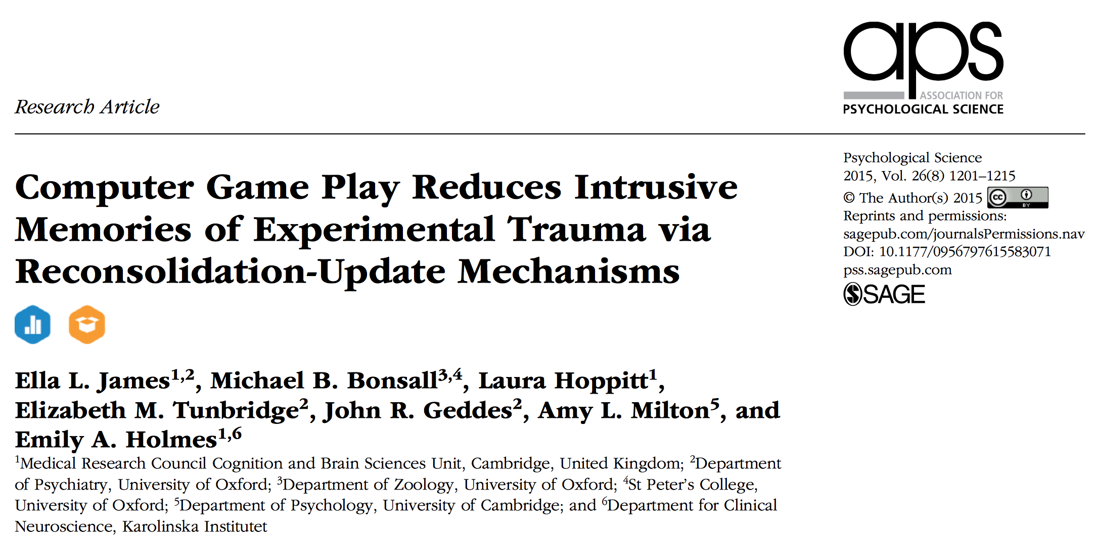
ANOVA lab example

Slide 13
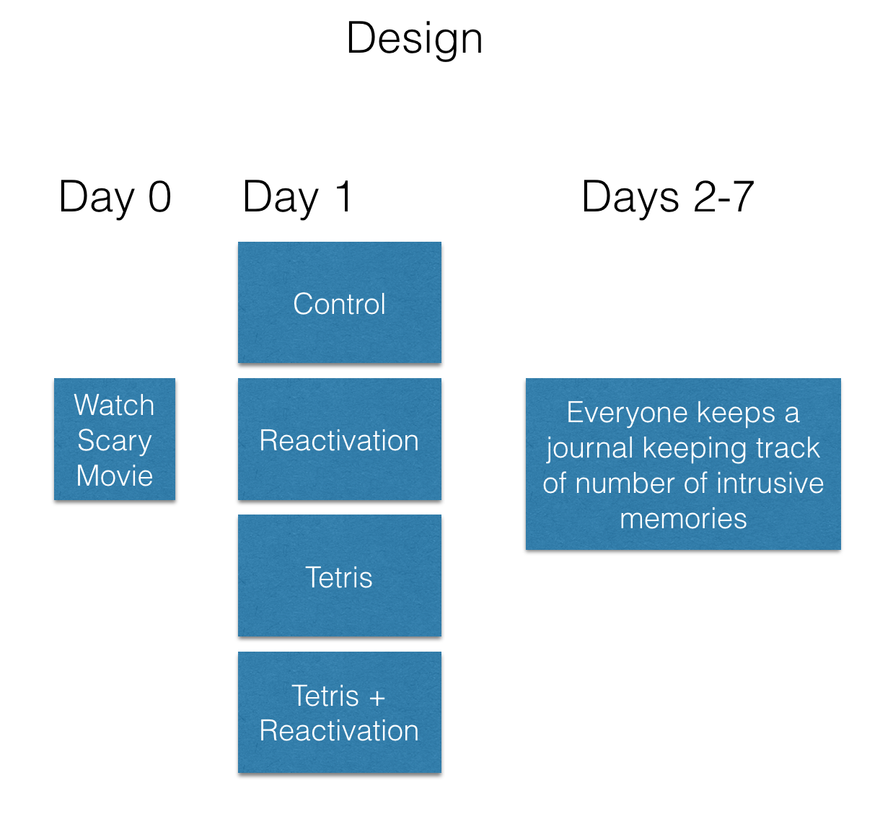
class: center, middle, clear, nopad

Slide 14
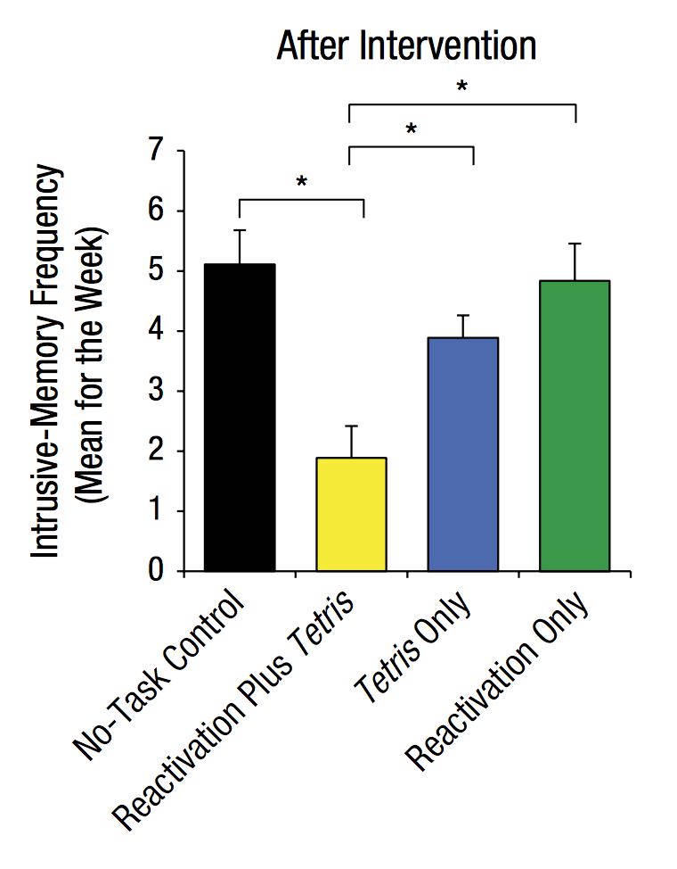
Results

Slide 15
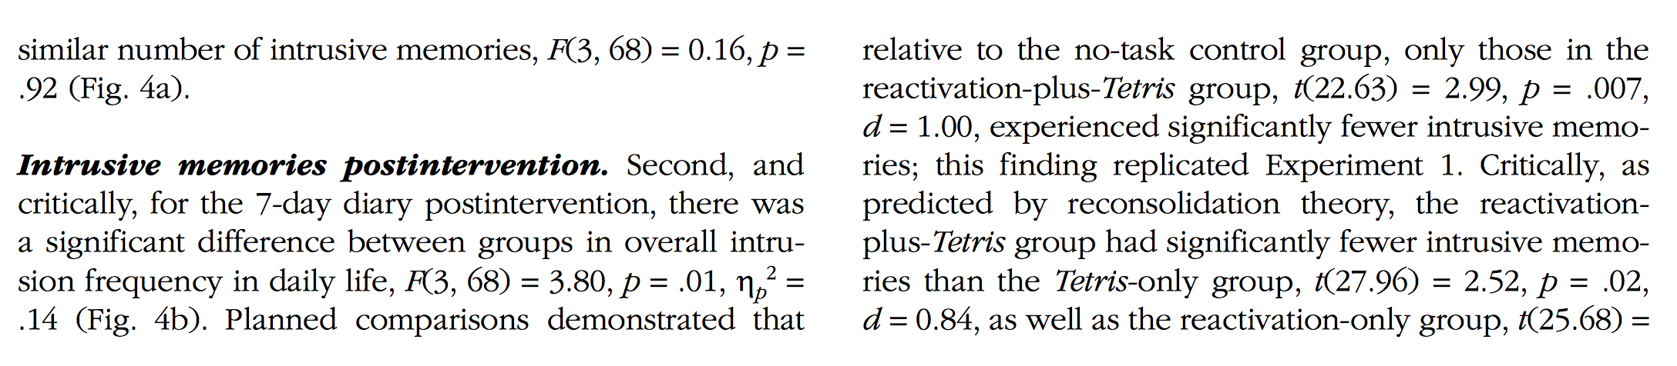
Write-up

Slide 16
Things we need to understand
The logic of the ANOVA
What each part of the ANOVA table tells us

Slide 17
ANOVA is an omnibus test
Omnibus definition: comprising many items
ANOVAs can test for differences among many means (2 or more)
Test question: Are there any differences among the means?
If the answer is yes, then we still do not know which specific means are different from one another.

Slide 18
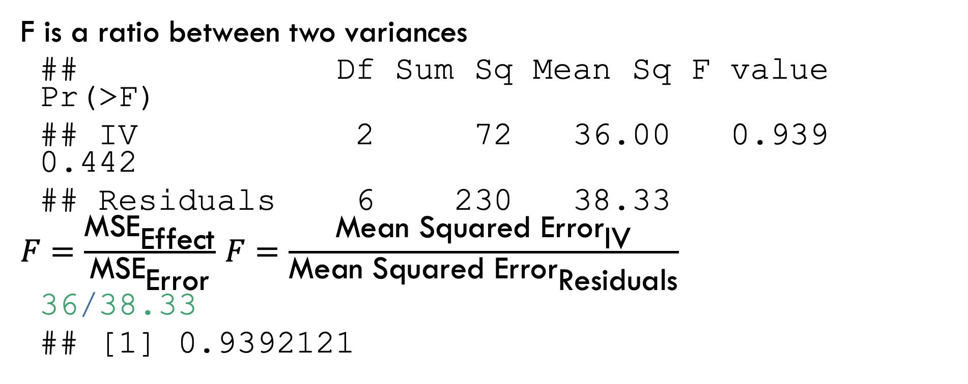
F-value
F is a ratio between two variances
## Df Sum Sq Mean Sq F value Pr(>F) ## IV 2 72 36.00 0.939 0.442 ## Residuals 6 230 38.33
$F=\frac{{\text{MSE}}_{\text{Effect}}}{{\text{MSE}}_{\text{Error}}}$ $F=\frac{{\text{Mean} \text{Squared} \text{Error}}_{\text{IV}}}{{\text{Mean} \text{Squared} \text{Error}}_{\text{Residuals}}}$
36/38.33
## [1] 0.9392121

Slide 19
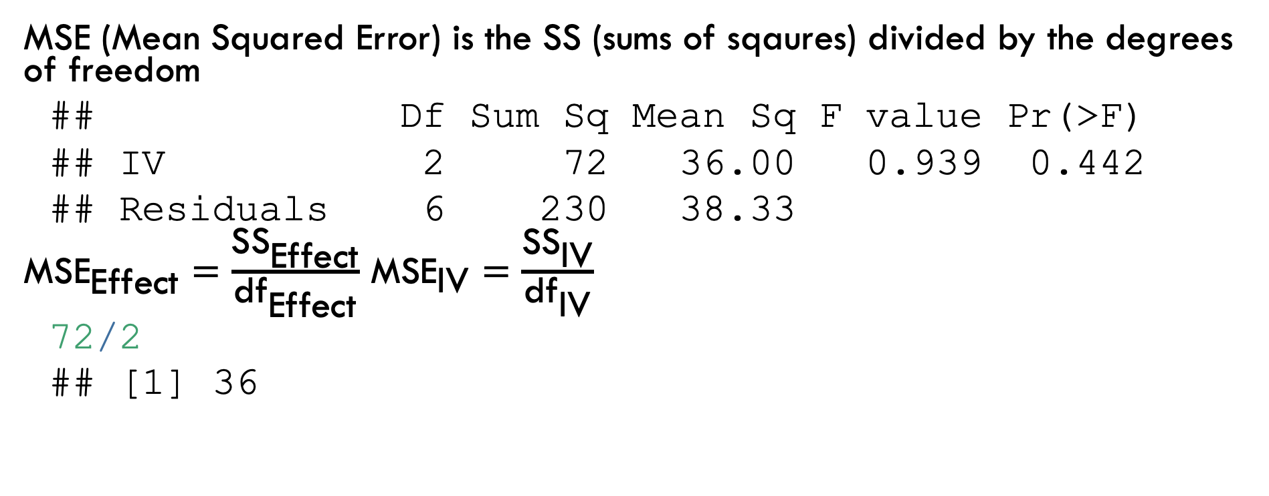
MSE: Mean squared Error (effect)
MSE (Mean Squared Error) is the SS (sums of sqaures) divided by the degrees of freedom
## Df Sum Sq Mean Sq F value Pr(>F) ## IV 2 72 36.00 0.939 0.442 ## Residuals 6 230 38.33
${\text{MSE}}_{\text{Effect}}=\frac{{\text{SS}}_{\text{Effect}}}{{\text{df}}_{\text{Effect}}}$ ${\text{MSE}}_{\text{IV}}=\frac{{\text{SS}}_{\text{IV}}}{{\text{df}}_{\text{IV}}}$
72/2
## [1] 36

Slide 20
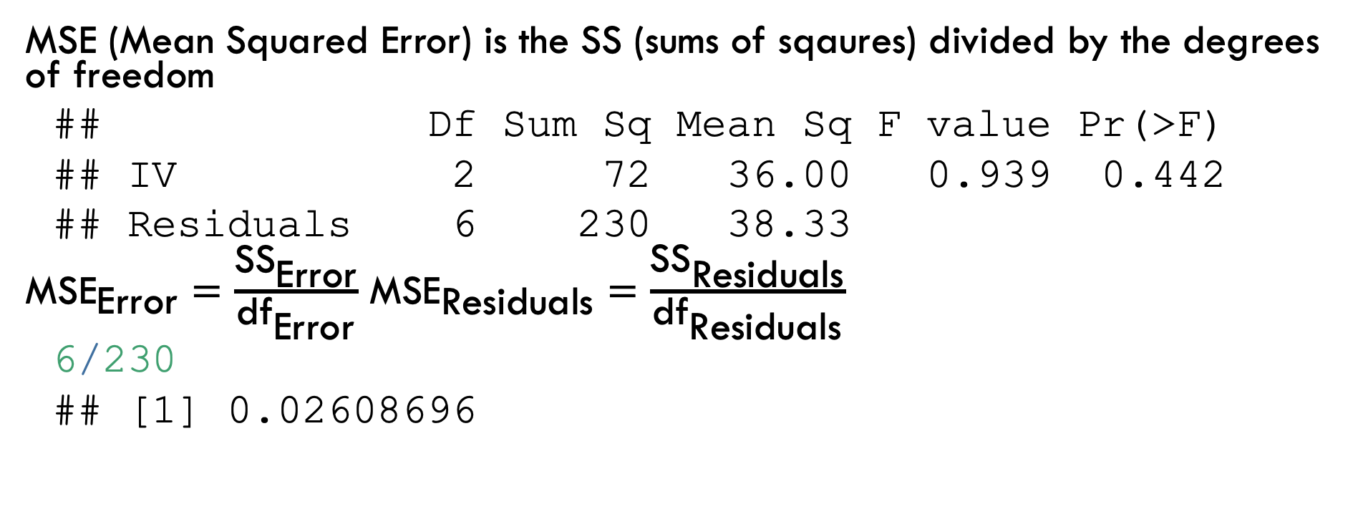
MSE: Mean squared Error (error)
MSE (Mean Squared Error) is the SS (sums of sqaures) divided by the degrees of freedom
## Df Sum Sq Mean Sq F value Pr(>F) ## IV 2 72 36.00 0.939 0.442 ## Residuals 6 230 38.33
${\text{MSE}}_{\text{Error}}=\frac{{\text{SS}}_{\text{Error}}}{{\text{df}}_{\text{Error}}}$ ${\text{MSE}}_{\text{Residuals}}=\frac{{\text{SS}}_{\text{Residuals}}}{{\text{df}}_{\text{Residuals}}}$
6/230
## [1] 0.02608696

Slide 21
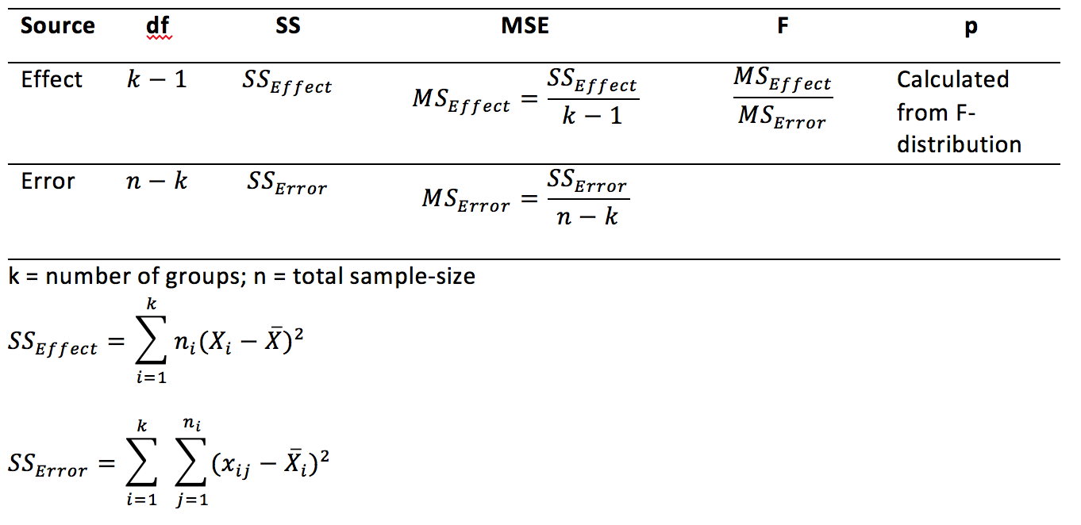
ANOVA reference table

Slide 22
The big idea

Slide 23
Partitioning the Variance
Idea is to split up the variance in the data into two parts:
The part due to the manipulation (IV)
The leftover part, due to random error

Slide 24
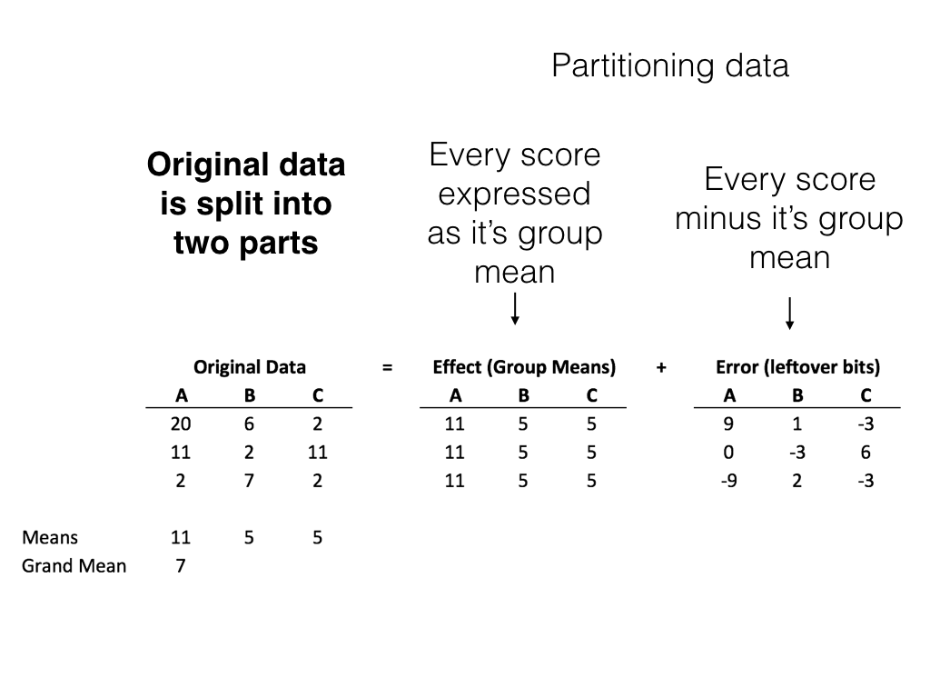
class: center, middle, clear, nopad

Slide 25
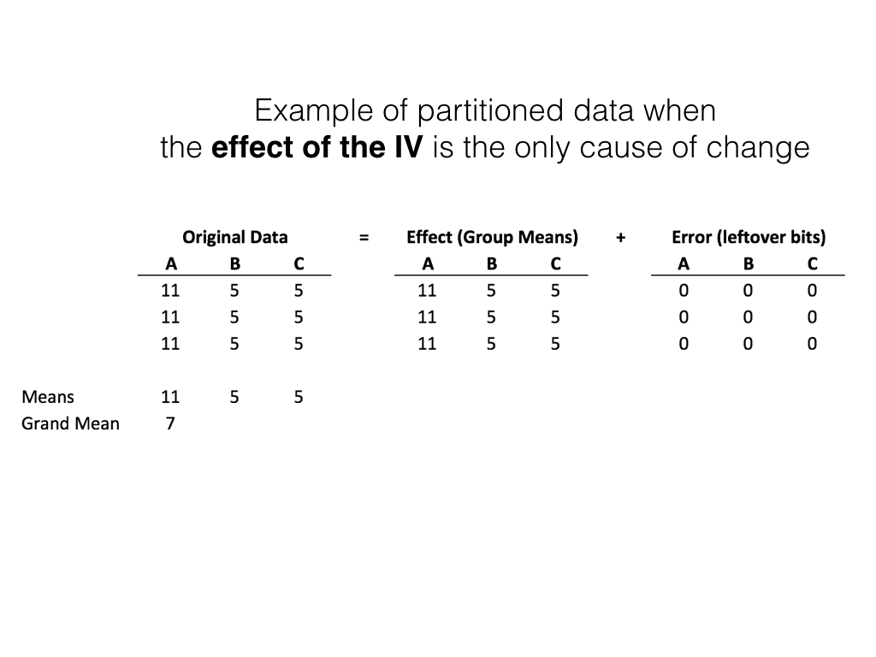
class: center, middle, clear, nopad

Slide 26
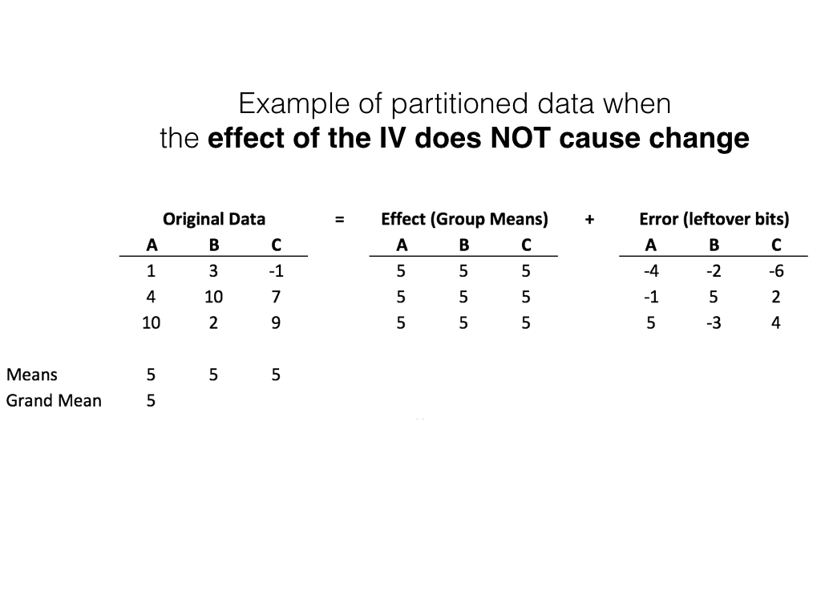
class: center, middle, clear, nopad

Slide 27
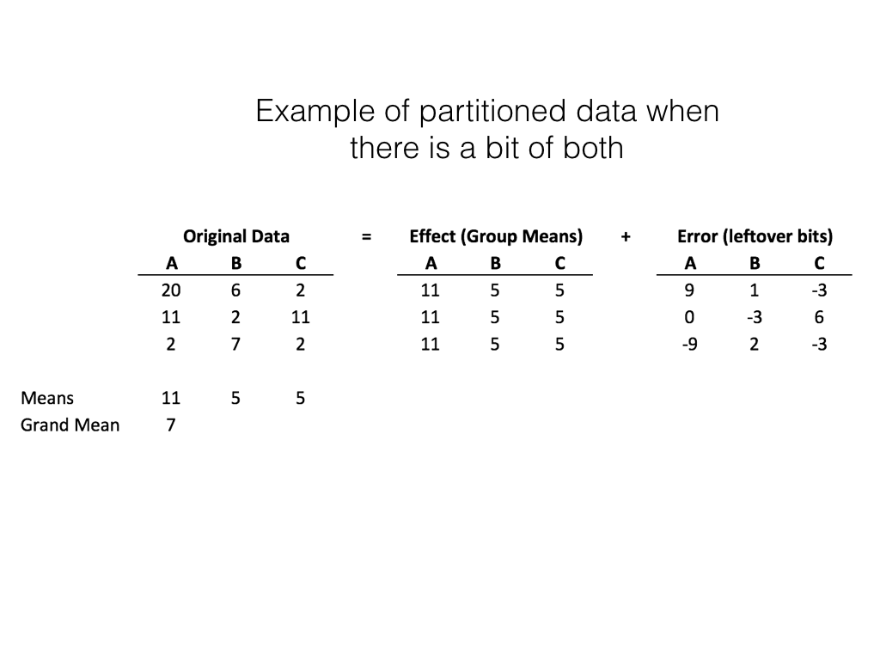
class: center, middle, clear, nopad

Slide 28
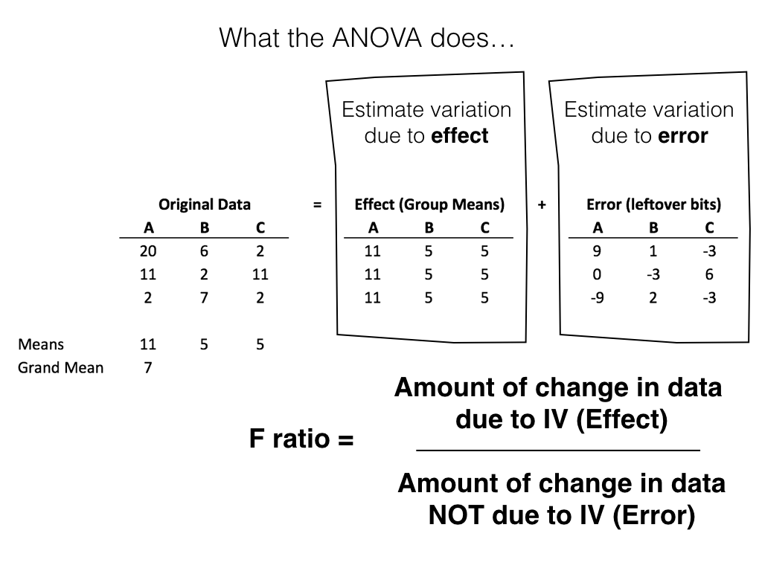
class: center, middle, clear, nopad

Slide 29
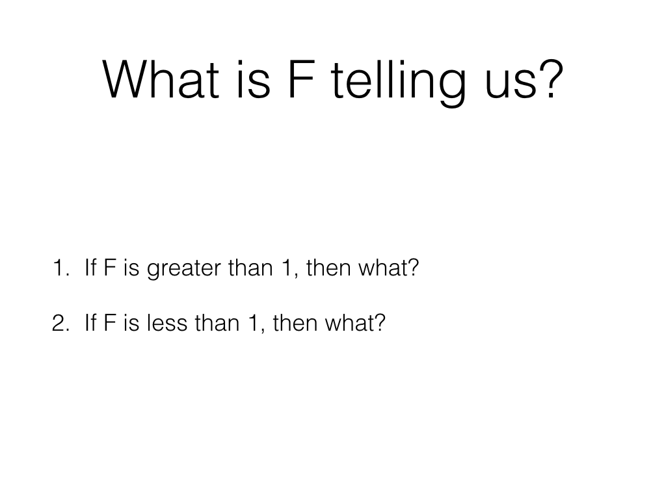
class: center, middle, clear, nopad

Slide 30
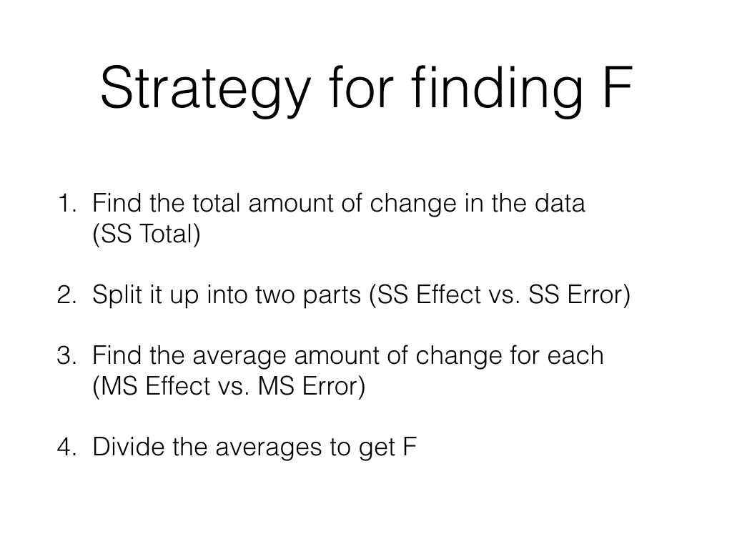
class: center, middle, clear, nopad

Slide 31
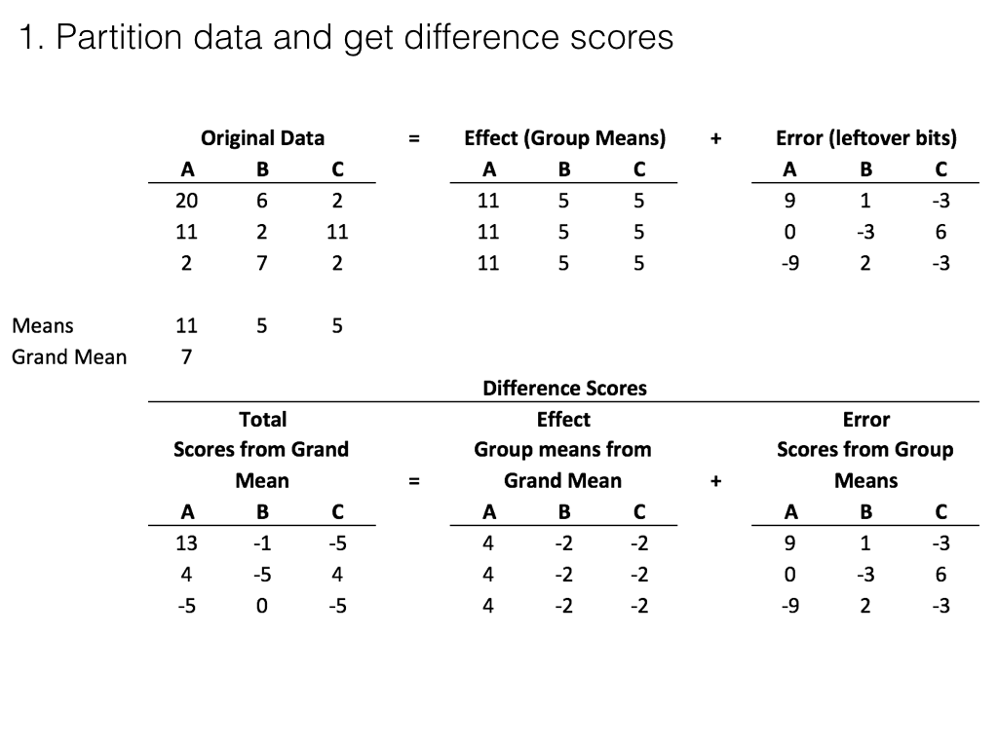
class: center, middle, clear, nopad

Slide 32
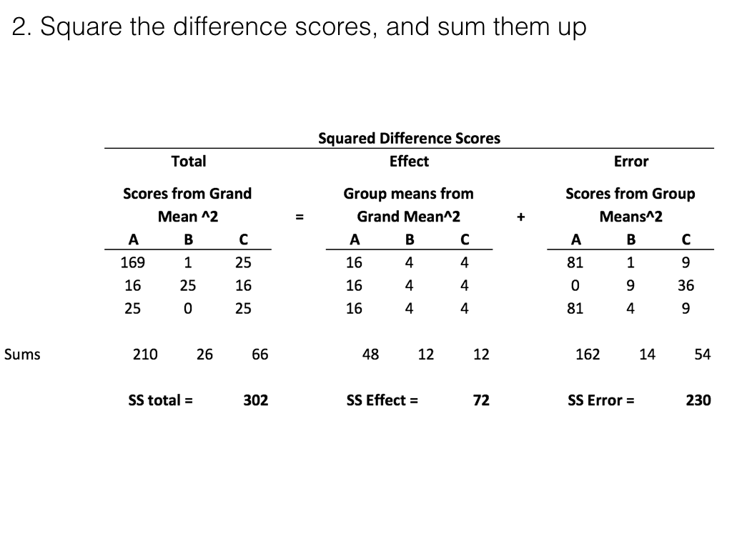
class: center, middle, clear, nopad

Slide 33
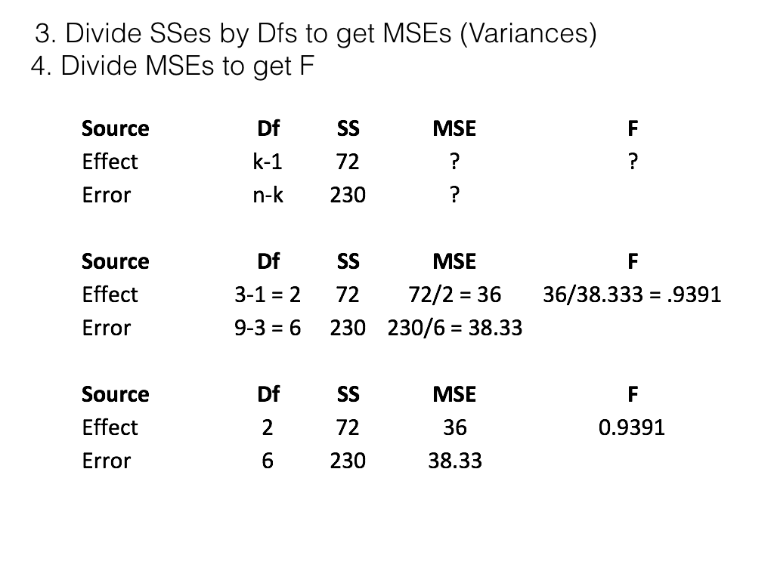
class: center, middle, clear, nopad

Slide 34
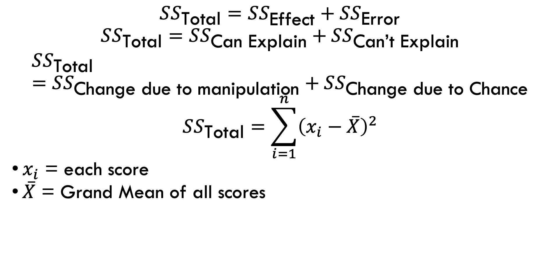
SS total
$$SS_{\text{Total}}=SS_{\text{Effect}}+SS_{\text{Error}}$$
$$SS_{\text{Total}}=SS_{\text{Can} \text{Explain}}+SS_{\text{Can}\text{’}\text{t} \text{Explain}}$$
$$SS_{\text{Total}}=SS_{\text{Change} \text{due} \text{to} \text{manipulation}}+SS_{\text{Change} \text{due} \text{to} \text{Chance}}$$
$$SS_{\text{Total}}=\sum_{i=1}^{n}{{\left(x_{i}−\overset{‾}{X}\right)}^{2}}$$
$x_{i}$ = each score
$\overset{‾}{X}$ = Grand Mean of all scores

Slide 35
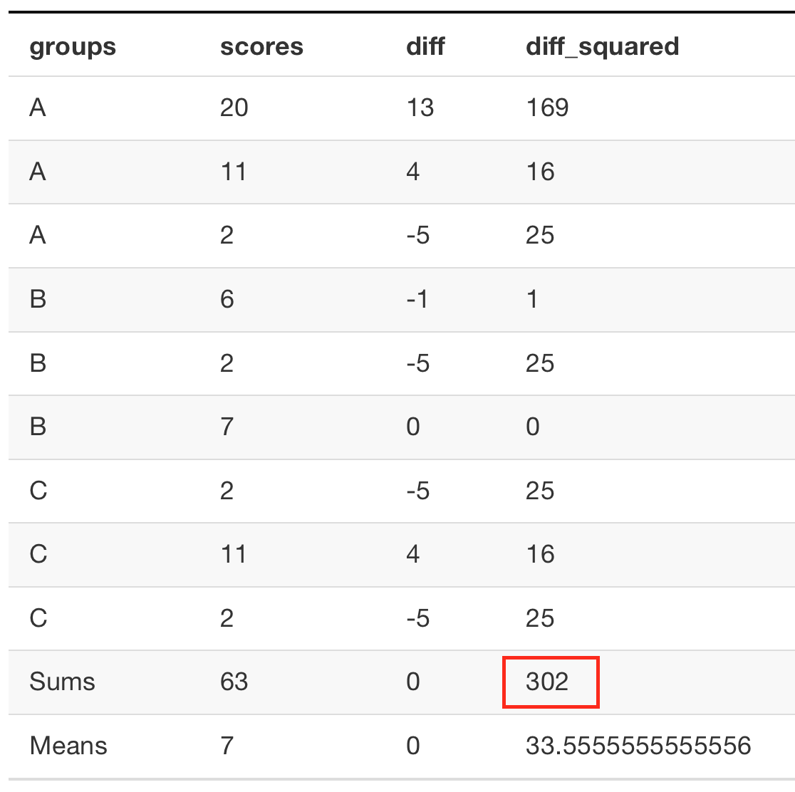
SS total example

Slide 36
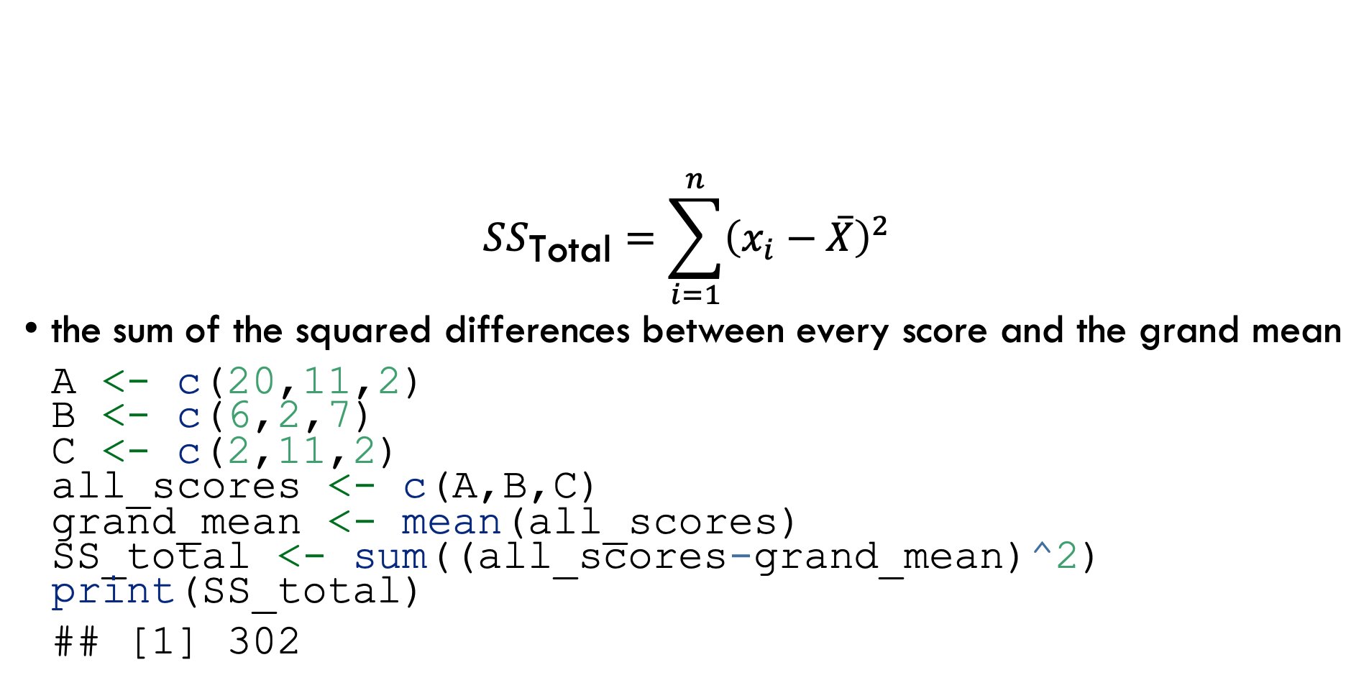
R: SS total
$$SS_{\text{Total}}=\sum_{i=1}^{n}{{\left(x_{i}−\overset{‾}{X}\right)}^{2}}$$
the sum of the squared differences between every score and the grand mean
A <- c(20,11,2) B <- c(6,2,7) C <- c(2,11,2) all_scores <- c(A,B,C) grand_mean <- mean(all_scores) SS_total <- sum((all_scores-grand_mean)^2) print(SS_total)
## [1] 302

Slide 37
Remember what SS represents?
SS (the sums of squares) is a single number representing the sum of all of the change in the data.
Specifically, the squared deviations from each score from the mean

Slide 38
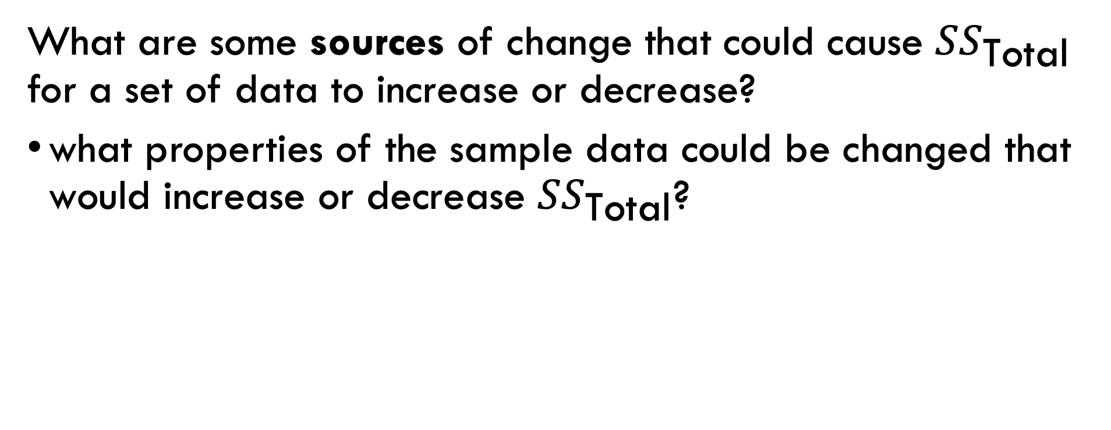
Question
What are some sources of change that could cause $SS_{\text{Total}}$ for a set of data to increase or decrease?
what properties of the sample data could be changed that would increase or decrease $SS_{\text{Total}}$?

Slide 39
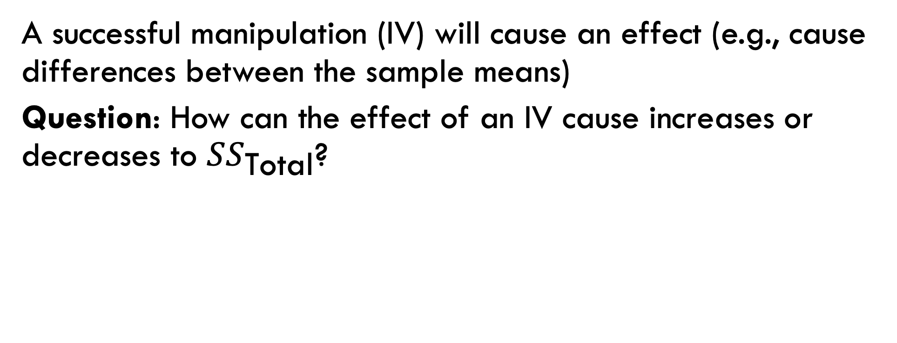
SS total and the Effect (IV)
A successful manipulation (IV) will cause an effect (e.g., cause differences between the sample means)
Question: How can the effect of an IV cause increases or decreases to $SS_{\text{Total}}$?

Slide 40
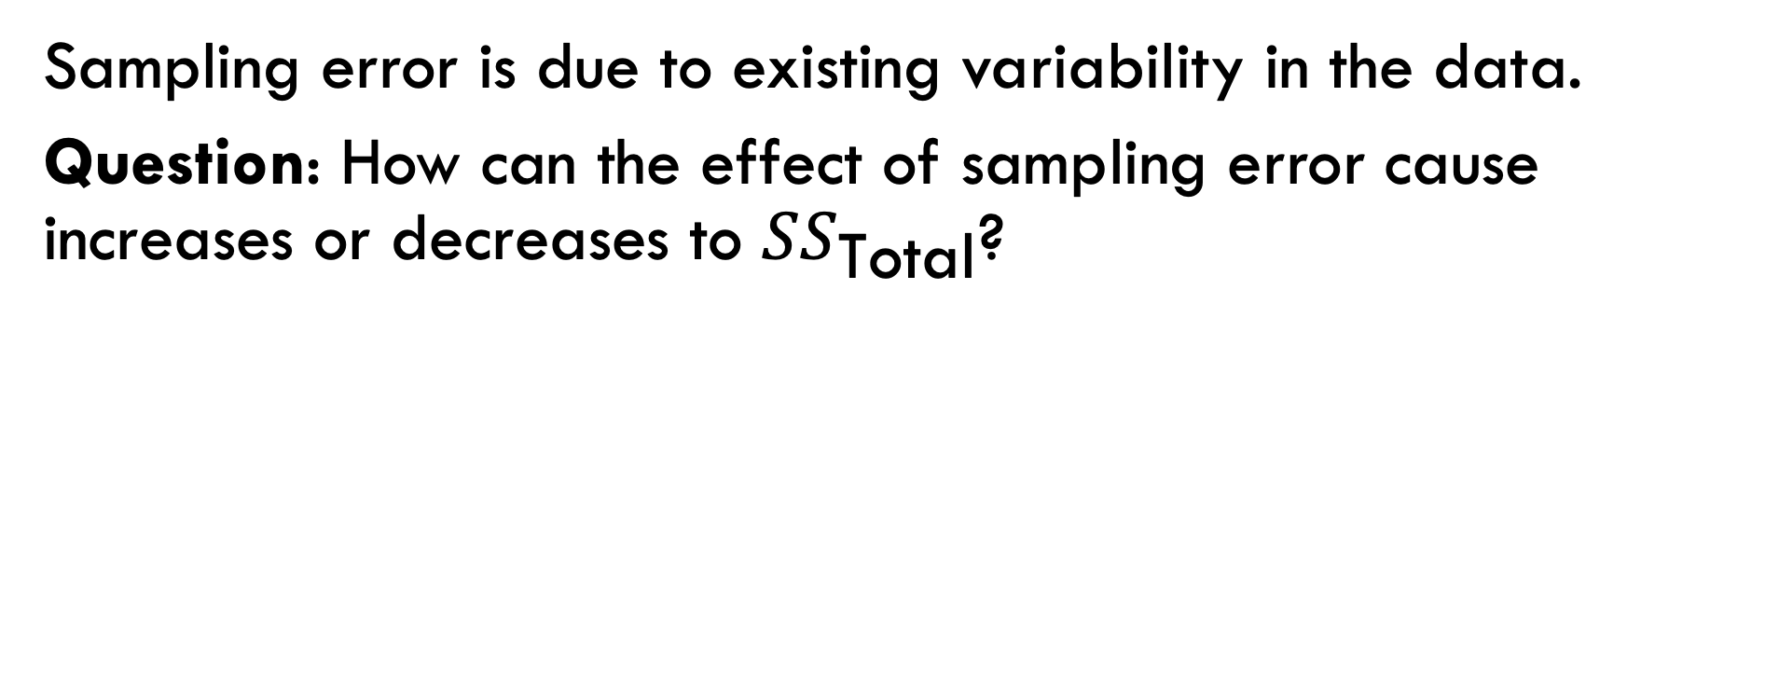
SS total and sampling error
Sampling error is due to existing variability in the data.
Question: How can the effect of sampling error cause increases or decreases to $SS_{\text{Total}}$?

Slide 41
The F-distribution
Let’s examine some ANOVA concepts by simulation in R.
https://crumplab.github.io/psyc3400/Presentations/bw_ANOVA.html

Slide 42
The entire ANOVA table: Step 1
Put the data into a dataframe. One column should code the levels of the IV, and the other column should include the DV
A <- c(20,11,2) B <- c(6,2,7) C <- c(2,11,2) IV <- as.factor(rep(c("A","B","C"),each=3)) DV <- c(A,B,C) df <- data.frame(IV,DV)

Slide 43
The entire ANOVA table: Step 2
summary(aov(DV~IV, df))
## Df Sum Sq Mean Sq F value Pr(>F) ## IV 2 72 36.00 0.939 0.442 ## Residuals 6 230 38.33

Slide 44
SS total
The sum of the squared deviations between each score and the grand mean.
A <- c(20,11,2) B <- c(6,2,7) C <- c(2,11,2) all_scores <- c(A,B,C) grand_mean <- mean(all_scores) SS_total <- sum((all_scores-grand_mean)^2) print(SS_total)
## [1] 302

Slide 45
SS total using the ANOVA table
Add up both of the Sums of Squares…
summary(aov(DV~IV, df))
## Df Sum Sq Mean Sq F value Pr(>F) ## IV 2 72 36.00 0.939 0.442 ## Residuals 6 230 38.33

Slide 46
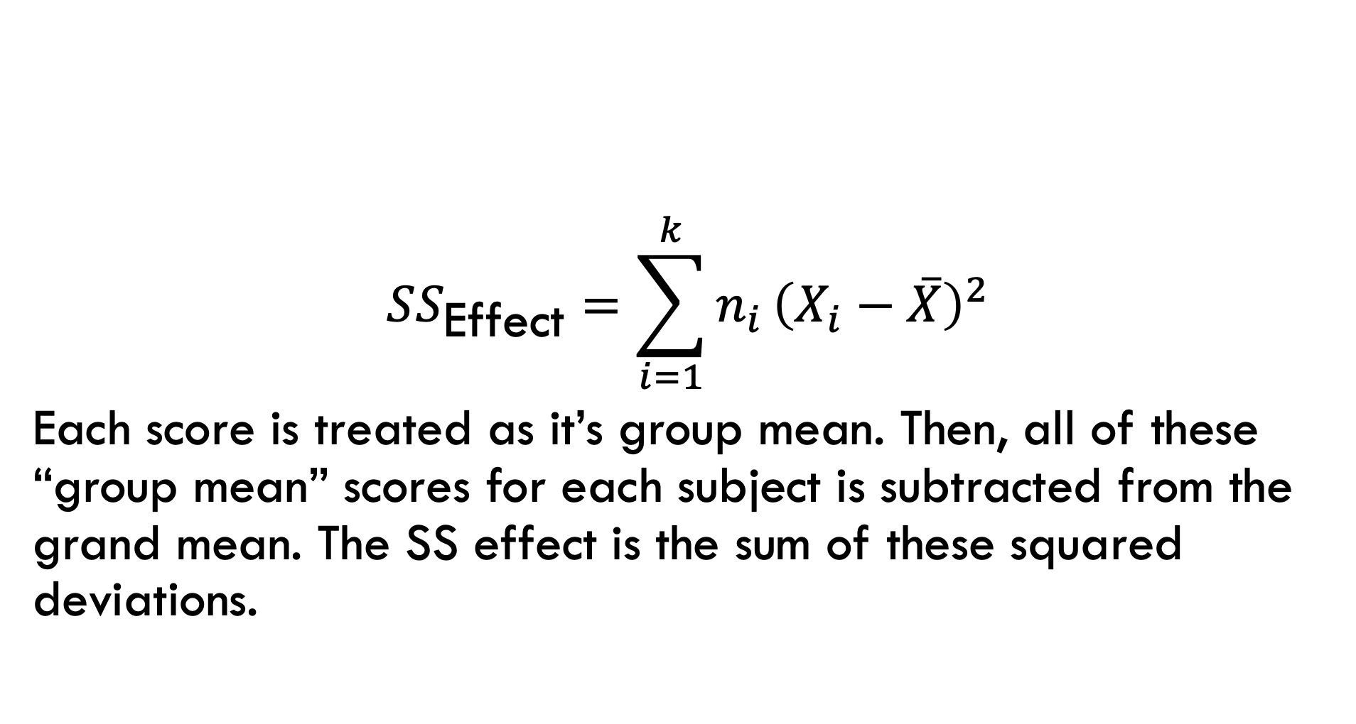
SS effect
$$SS_{\text{Effect}}=\sum_{i=1}^{k}{n_{i}}{\left(X_{i}−\overset{‾}{X}\right)}^{2}$$
Each score is treated as it’s group mean. Then, all of these “group mean” scores for each subject is subtracted from the grand mean. The SS effect is the sum of these squared deviations.

Slide 47
R: SS effect
A <- c(20,11,2) B <- c(6,2,7) C <- c(2,11,2) grand_mean <- mean(c(A,B,C)) scores_as_grp_means <- c(rep(mean(A),3), rep(mean(B),3), rep(mean(C),3)) SS_Effect <- sum((scores_as_grp_means-grand_mean)^2) print(SS_Effect)
## [1] 72

Slide 48
SS effect from ANOVA table
Or, just look at the Sums of squares in the first row of the ANOVA table (for IV in this case, which represents the effect).
summary(aov(DV~IV, df))
## Df Sum Sq Mean Sq F value Pr(>F) ## IV 2 72 36.00 0.939 0.442 ## Residuals 6 230 38.33

Slide 49
SS error
The sum of the squared deviations between each score and it’s group mean.

Slide 50
R: SS error
A <- c(20,11,2) B <- c(6,2,7) C <- c(2,11,2) scores_as_grp_means <- c(rep(mean(A),3), rep(mean(B),3), rep(mean(C),3)) SS_Error <- sum((scores_as_grp_means-c(A,B,C))^2) print(SS_Error)
## [1] 230

Slide 51
SS error from ANOVA table
Or, just look at the Sums of squares in the second row of the ANOVA table (for residuals in this case, which represents the error).
summary(aov(DV~IV, df))
## Df Sum Sq Mean Sq F value Pr(>F) ## IV 2 72 36.00 0.939 0.442 ## Residuals 6 230 38.33

Slide 52
Getting F and p from ANOVA table
Put the ANOVA summary into a variable
anova_variable <- summary(aov(DV~IV, df))
Get F and associated p
anova_variable[[1]]$`F value`
## [1] 0.9391304 NA
anova_variable[[1]]$`Pr(>F)`
## [1] 0.4417359 NA

Slide 53
Getting Df, SS, and MS
anova_variable[[1]]$Df
## [1] 2 6
anova_variable[[1]]$`Sum Sq`
## [1] 72 230
anova_variable[[1]]$`Mean Sq`
## [1] 36.00000 38.33333

Slide 54
Analysis of Variance (ANOVA)
What happens when we have one continuous DV, and one categorical IV with 2 or more levels, and/or more than one categorical IV with 2 or more levels each?
We use a NEW test!! Analysis of Variance (ANOVA)
One-Way Analysis of Variance (One-Way ANOVA): a statistical procedure used to test hypotheses about one categorical IV (called a “factor”) with two or more levels, concerning the variance among group means of one continuous DV (Chapter 11)
The “One-way” in the name indicates the number of categorical IV’s being tested (NOT the number of levels in each IV!!)
One-Way ANOVA tests hypotheses about one categorical IV with two or more levels (Chapter 11)
Two-Way ANOVA tests hypotheses about two categorical IVs, each with two or more levels (Chapter 12)
Three-Way ANOVA tests hypotheses about three categorical IVs, each with two or more levels (We won’t cover these in PSYC2111)

Slide 55

2 Types of One-Way ANOVA
2 Types of One-Way ANOVA (used for a continuous DV, and one categorical IV with 2 or more levels):
One-Way Between-Subjects ANOVA
One-Way Within-Subjects ANOVA
One-Way Between-Subjects ANOVA: used when different participants are observed at each level of the one categorical IV.
Example: A sample of patients with equivalent levels of chronic back pain are randomly assigned to one of 3 treatment conditions: 1) Drug A, 2) Drug B, 3) Placebo sugar pill. Pain severity measured on a 0-10 scale (continuous DV) is measured in each treatment group after 1 month of treatment

Slide 56

2 Types of One-Way ANOVA
2 Types of One-Way ANOVA (used for a continuous DV, and one categorical IV with 2 or more levels):
One-Way Between-Subjects ANOVA
One-Way Within-Subjects ANOVA
One-Way Within-Subjects ANOVA: used when the same participants are observed at each level of the one categorical IV.
Example: A sample of professional athletes is recruited. Each athlete’s speed is measured in meters per second (continuous DV) is recorded running the hundred-yard dash in each of 3 running conditions: 1) wearing Adidas shoes, 2) wearing Brooks shoes, 3) wearing Nike shoes.

Slide 57
What Type of ANOVA?
In summary, the type of ANOVA test is dictated by 2 things:
The number of IV’s (factors) being tested
In a one-way ANOVA, one IV is tested
In a two-way ANOVA, two IV’s are tested, and so on…
How the participants are observed across each level of the IV:
Within-subjects design: participants experience/are measured at every level of the IV
Between-subjects design: participants are measured only once at one level of the IV

Slide 58

ANOVA Terminology
n = number of participants per group (not total number in a sample)
N = total number of participants in in the whole study (not total number in a population)
k = the number of levels in one categorical IV (i.e. the number of levels in one factor variable)
Example: A sample of patients (N=90) with equivalent levels of chronic back pain are randomly assigned to one of 3 treatment conditions (k=3): 1) Drug A (n=30), 2) Drug B (n=30), 3) Placebo sugar pill (n=30).
N=90 patients in the whole study; n=30 patients in each treatment group; k=3 treatment groups (3 levels of the one IV called “treatment”)

Slide 59

Learning Check!
Example: A sample of 75 CU Boulder undergraduate students are recruited directly after graduation and asked to respond to the statement “I am satisfied with my choice of undergraduate major” using a 7-point Likert scale (0=“strongly disagree” to 7=“strongly agree”). The students were evenly distributed across 3 majors: 1) Psychology, 2) Sociology, 3) Biology. There were no double-majors.
What is the appropriate test to answer the question: did satisfaction with undergraduate major at graduation depend on which major was declared?
One-Way ANOVA
Is this a between-subjects or within subjects design?
Between-subjects
What are N, n, and k?
N=75; n=25 (1/3 in each major); k=3 (3 levels)

Slide 60
Learning Check!
Example: A sample of 75 CU Boulder undergraduate students are asked whether they are satisfied with their choice of undergraduate major at each of 4 time points: 1) directly after declaring, 2) directly after graduation, 3) one year post-graduation, 4) 5-years post-graduation. Satisfaction the same 7-point Likert scale: “I am satisfied with my choice of undergraduate major” (0=“strongly disagree” to 7=“strongly agree”).
What is the appropriate test to answer the question: did satisfaction with undergraduate major depend on when the question was asked?
One-Way ANOVA
Is this a between-subjects or within subjects design?
Within-subjects
What are N, n, and k?
N=75; n=75 (everyone is in all 3 IV levels); k=4 (4 levels)

Slide 61
Sources of Variation
ANOVA’s evaluate if the means in each group significantly vary.
Range of variance between group means: 0 to positive infinity
If all means are equal ➔ variance of group means = 0
The larger the difference between the group means, the larger the variance of group means
In a One-Way Between-Subjects ANOVA, there are 2 ways in which the means can vary (a.k.a. 2 Sources of Variation):
Between-groups variation: the variation attributed to mean difference between groups
Within-groups variation: the variation attributed to mean differences within each group. This source of variation cannot be attributed to differences between groups, and is therefore called “error variation” (attributed to error or chance).

Slide 62
Sources of Variation
Between-groups variation: variation attributed to the mean difference between groups
Within-groups variation: variation attributed to the mean differences within each group; called “error variation” (attributed to error or chance).

Slide 63
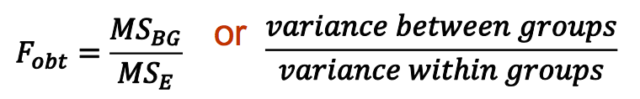
ANOVA Test Statistic: “F”
ANOVA’s are also called “F Tests”
Test Statistic for an ANOVA = F (i.e., F_{cv}; F_{obt})
Formula in Words: mean square (or variance) between groups divided by the mean square (or variance) within groups
The distribution of all possible outcomes for the F test statistic is positively skewed (because variance cannot be negative!)
The distribution, called the F distribution, is derived from a sampling distribution of F ratios

Slide 64
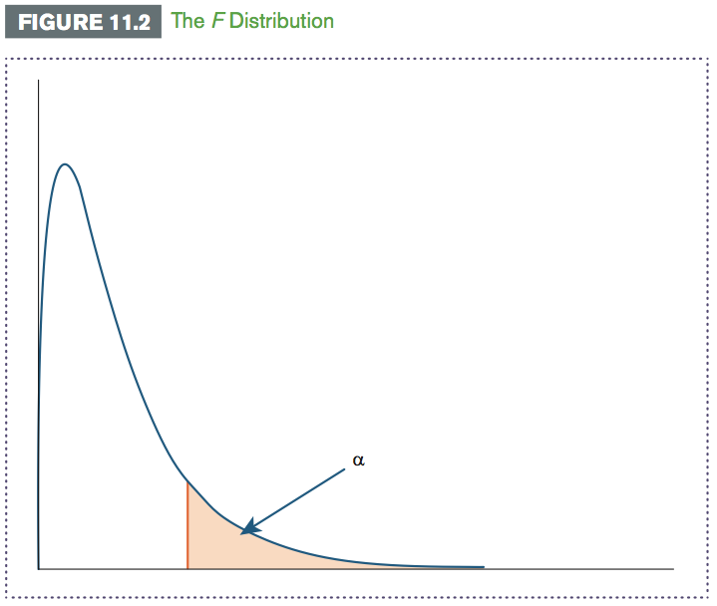
ANOVA Test Statistic: “F”
Alpha cut-off will always be in one tail of the F Distribution!

Slide 65
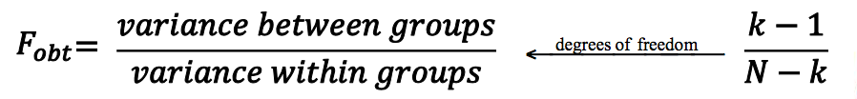
Degrees of Freedom (df)
The df for a one-way between-subjects ANOVA is N – 1
You must split the total df (N – 1) into 2 parts: one for each source of variation:
Degrees of freedom between groups (df_{BG} ) or degrees of freedom numerator:
df_{BG} is the df associated with the variance for the group means in the numerator of the test statistic. It is equal to the number of groups (k) minus 1➔ k-1
Degrees of freedom error (df_{E}), degrees of freedom within groups, or degrees of freedom denominator:
df_{E} is the df associated with the error variance in the denominator. It is equal to the total sample size (N) minus the number of groups (k) ➔ N-k

Slide 66
4 Assumptions for One-Way Between-Subjects ANOVA
There are four assumptions to compute the one-way between-subjects ANOVA:
Normality: assume that data in the population or populations being sampled from are normally distributed
Random Sampling: assume data measured were obtained from a sample that was selected using a random sampling procedure
Independence: assume that the probabilities of each measured outcome in a study are independent or equal
Homogeneity of Variance: assume that the variance in each population is equal to each other
Sample size (n) must be equal in each group!

Slide 67
One-Way Between-Subjects ANOVA Example
Example: Employee turnover is costly to businesses, and thus is a common research topic among Organizational Psychologists! Suppose an Organizational Psychologist were interested in whether stress levels in the workplace predict how long employees are willing to stay at a company. They recruit 30 employees at a major local company. Employees report their stress levels and are broken up evenly into 3 groups based on how stressful they rate the workplace: 1) Low stress, 2) Moderate stress, 3) High stress. Employees also report the time (in years) they predict they would remain at the company. Conduct an ANOVA to analyze significance of data at a .05 level of significance.
What is the appropriate type of ANOVA for this example? Why?
One-Way Between Subjects ANOVA –one IV, each person is only in one level of the 1V (either in Low, or Moderate, or High stress group)
What are N, n, and k?
N=30, n=10, k=3

Slide 68
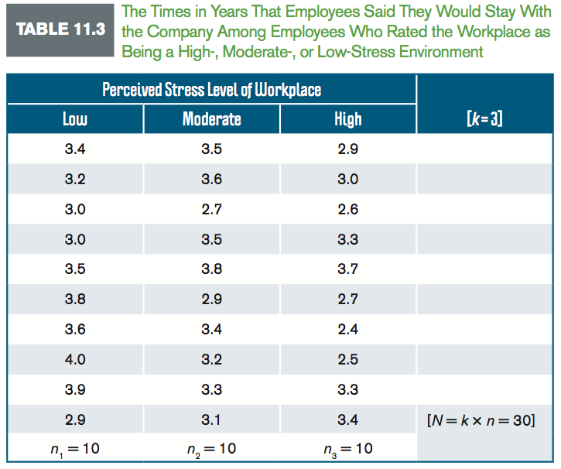
One-Way Between-Subjects ANOVA Example

Slide 69
One-Way Between-Subjects ANOVA Example
STEP 1: State the Hypotheses:
H₀: σ²_{μ} = 0 ➔ In words: group means (μ) do not vary (σ²) in the company employee population
H₁: σ²_{μ} > 0 ➔ In words: group means in the company employee population do vary
STEP 2: Set the criteria for a decision
Level of significance is .05
df_{BG}= k-1: 3-1 = 2
df_{E} = N-k: 30-3 = 27
Critical value is 3.35 (Table B.3, Appendix B)

Slide 70

One-Way Between-Subjects ANOVA Example
Use the F Table in B.3 in Appendix B to find F_{cv}:
df_{BG} (numerator)= k-1: 3-1 = 2
df_{E} (denominator)= N-k: 30-3 = 27
Fcv = 3.35
Degrees of Freedom
in the numerator
BOLD: α=.01
NOT Bold: α=.05
Degrees of Freedom
in the denominator

Slide 71
One-Way Between-Subjects ANOVA Example
Use the F Table in B.3 in Appendix B to find F_{cv}:
df_{BG} (numerator)= k-1: 3-1 = 2
df_{E} (denominator)= N-k: 30-3 = 27
Fcv = 3.35

Slide 72
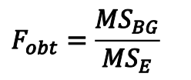
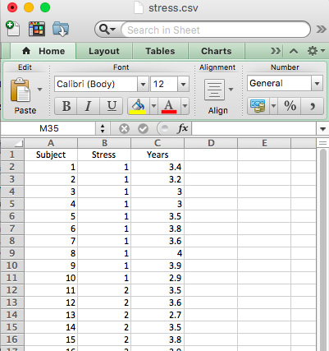
One-Way Between-Subjects ANOVA Example
STEP 3: Compute the Test Statistic
We are going to do this in R!
First enter the data into Excel: one row per subject, all levels of the IV in one column:
Then save as a “.csv” file
Import your dataset into R

Slide 73
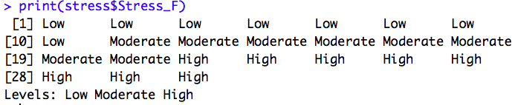
One-Way Between-Subjects ANOVA Example
STEP 3: Compute the Test Statistic
#Input the Dataset "stress" into R
stress <-read.csv(file.choose())
stress
#STEP 1: Code the variable "Stress" as a factor with three levels: "Low", "Moderate", "High"
stress$Stress_F <- factor(stress$Stress, labels= c("Low", "Moderate", "High"))

Slide 74
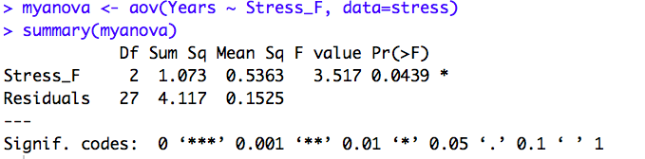
One-Way Between-Subjects ANOVA Example
STEP 3: Compute the Test Statistic
#STEP 2: The "Omnibus Test" -- Run a One-Way Between-Subjects ANOVA to test if there are any differences between the groups!
#Generic code:
myanova <- aov(DV ~ IV, data=datasetname)
#Applied code:
myanova <- aov(Years ~ Stress_F, data=stress)
summary(myanova)

Slide 75
One-Way Between-Subjects ANOVA Example
“Df” is degrees of freedom: “Stress_F” row is the df_{BG}=2; “Residuals” means error so this row is the df_{E}=27
F value is F_{obt}=3.52
Pr(>F) is the p value for the Omnibus test
“Mean Sq” is mean square (MS):
MS_{BG} .5363/MS_{E} .1525=3.517 (=F)

Slide 76
One-Way Between-Subjects ANOVA Example
STEP 4: Make a Decision
|Fobt=3.517| >|Fcv=3.35| ➔ Reject the Null! There is at least one difference between the means!
But WHERE is the difference?

Slide 77
One-Way Between-Subjects ANOVA Example
But WHERE is the difference between the means? Options:
Option 1. All the means are different: μ₁≠μ₂≠μ₃
Option 2. Two means are the same, one is different: μ₁=μ₂≠μ₃
Option 3. All means are the same: μ₁=μ₂=μ₃

Slide 78
Post Hoc Tests
WHEN: How do we know where the significant difference is? When the ANOVA “omnibus” (overall) test is significant, conduct Post Hoc Tests to determine which pair or pairs of group means significantly differ from one another!
Post Hoc Test: statistical procedure computed following a significant ANOVA to determine which pair or pairs of group means significantly differ
These tests are necessary when k > 2 because multiple comparisons are needed
A Post Hoc Test evaluates all possible pairwise comparisons (i.e., comparisons between a pair of means) for an ANOVA with any number of groups
Which Post Hoc Test? We will use Tukey’s Honestly Significant Difference (HSD)

Slide 79
Post Hoc Tests
When do we compute a Post Hoc Test?

Slide 80
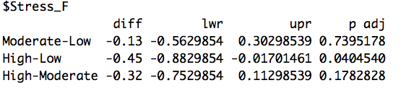
Post Hoc Tests
WHEN: How do we know where the significant difference is? When the ANOVA “omnibus” (overall) test is significant, conduct Post Hoc Tests to determine which pair or pairs of group means significantly differ from one another!
HOW:
#STEP 4: Run the Tukey's HSD Posthoc Test -- Compute the Pairwise Comparisons to find where the significant mean difference is!
TukeyHSD(myanova)
These are p values!
High vs. Low is the only significant difference
(p=.04 <.05)

Slide 81
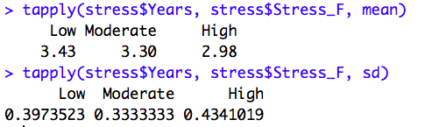
One-Way Between-Subjects ANOVA Example
STEP 4: Make a Decision & Write a Conclusion!
We still don’t know the mean and sd in each group!
#STEP 4: Use the "tapply" command to get the mean and sd for each group
tapply(stress$Years, stress$Stress_F, mean)
tapply(stress$Years, stress$Stress_F, sd)

Slide 82
One-Way Between-Subjects ANOVA Example
STEP 4: Make a Decision & Write a Conclusion!
A. Decision: Reject the null ➔ there is at least one significant difference between the means!
B. Post Hoc Test: Run all Pairwise comparisons to find the significant difference(s) ➔ High vs. Low was the only significant difference!
C. APA-Style Conclusion: Results of the One-Way Between-Subjects ANOVA indicated that perceived workplace stress significantly predicted employee turnover, F(2,27)=3.52, p<.05. Specifically, employees who perceived the workplace environment as low stress predicted they would stay significantly longer (M=3.43, SD=0.40 years) than did employees who perceived the workplace environment as high stress (M=2.98, SD=0.43 years; Tukey’s HSD, p<.05). Otherwise, no significant differences were evident (Tukey’s HSD, p>.05).
Stats Format: F(df_{BG}, df_{E})=F_{obt}, p<>α
Order: 1) State results of the Omnibus test, 2) if the Omnibus is significant, state the results of the Post Hoc tests

Slide 83
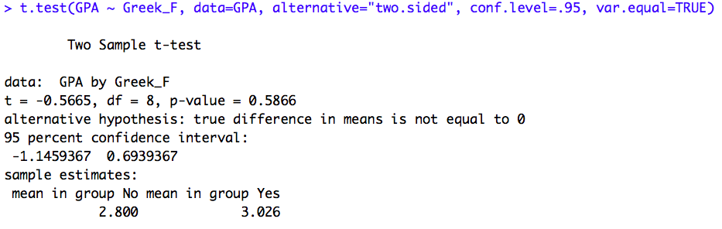
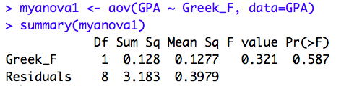
Relationship Between T_{obt} and F_{obt}
t measures the distance between two means in terms of standard deviations!
F measures the distance between two or more means in terms of variance!
Standard Deviation squared = Variance! ➔ t² = F!!
t_{obt}=-.5666^2 ➔ F_{obt}=-0.321
Notice the p values also match! (p=.587)

Slide 84
One-Way Within-Subjects ANOVA
One-Way Within-Subjects ANOVA: a statistical procedure used to test hypotheses for one categorical IV (factor) with two or more levels concerning the variance among group means. This test is used when the same participants are observed at each level of the IV and the variance in any one population is unknown.
The term “One-way” means that you are testing one IV
The term “Within-Subjects” means that the same participants are being observed in each group

Slide 85
4 Assumptions for One-Way Within-Subjects ANOVA
There are four assumptions you must make to compute the One-Way Within-Subjects ANOVA
Normality: assume that data in the population or populations being sampled from are normally distributed
Independence Within Groups: assume that participants are independently observed within groups, but not between groups
Homogeneity of Variance: assume that the variance in each population is equal to each other
Homogeneity of Covariance: assume that participant scores in each group are related because the same participants are observed across or between groups

Slide 86
Sources of Variation for One-Way Within-Subjects ANOVA
There are 3 Sources of Variation in One-Way Within-Subjects ANOVA:

Slide 87

One-Way Within-Subjects ANOVA Example
Example: Suppose we want to assess the effectiveness of three different ads on getting teens to quit smoking. A sample of teenagers (N=7) are asked to view each ad and to rate the ad’s effectiveness on a scale from 1= “not at all effective” to 7=“very effective”.
One ad uses words only (a No-Cues condition). A second ad uses a generic abstract picture (Generic-Cues condition). A third ad shows a picture of a teenager smoking and coughing (Smoking-Related Cues condition).
Conduct the one-way within-subjects ANOVA at a .05 level of significance.

Slide 88
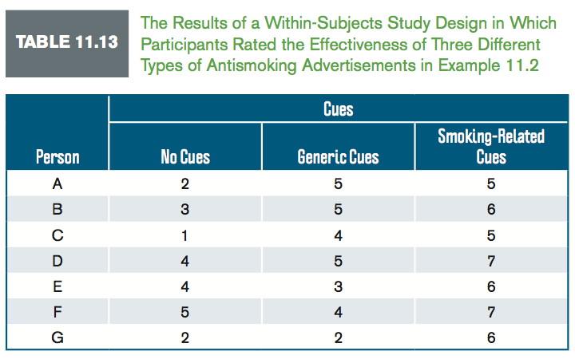
One-Way Within-Subjects ANOVA Example

Slide 89
One-Way Within-Subjects ANOVA Example
STEP 1: State the Hypotheses:
H₀: σ²_{μ} = 0 ➔ In words: Mean ratings for each advertisement do not vary in the population
H₁: σ²_{μ} > 0 ➔ In words: Mean ratings for each advertisement do vary in the population
STEP 2: Set the criteria for a decision
Level of significance is .05
Note: we are going to skip calculating df and Fcv and go straight to R!

Slide 90
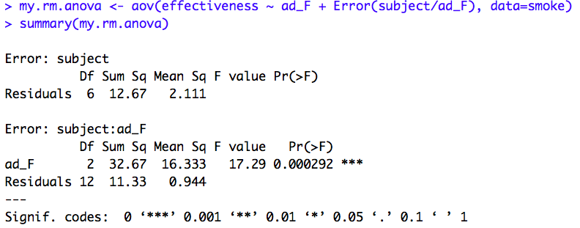
One-Way Within-Subjects ANOVA Example
STEP 3: Calculate the Test Statistic
Run the Omnibus One-Way Within-Subjects ANOVA test in R!
F value is F_{obt}=17.29
This is your p value for the “omnibus” (overall) One-Way Within Subjects ANOVA test; p<.05 ➔ reject the null! Variance between the means > 0!
These are your degrees of freedom
APA Conclusion: F(2,12)

Slide 91
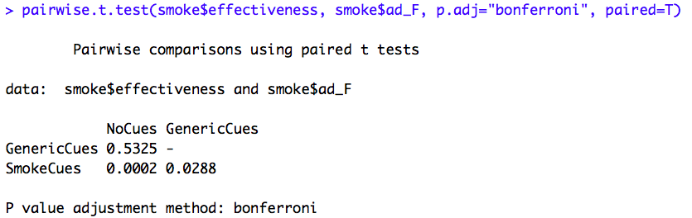
One-Way Within-Subjects ANOVA Example
STEP 3: Calculate the Test Statistic
Run the Omnibus One-Way Within-Subjects ANOVA test in R!
If significant (e.g., p<.05)➔ Reject the null ➔ Compute the Post Hoc Test to find where the mean differences are – here we will use a Bonferroni Post Hoc test!
These are your p values for each pairwise group comparison! Notice there is a significant difference between SmokeCues vs. NoCues (p=0.0002); and a significant difference between SmokeCues vs. GenericCues (p=0.0288); but the difference NoCues vs. GenericCues is NOT significant (p=0.5325).

Slide 92
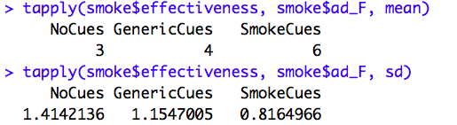
One-Way Within-Subjects ANOVA Example
STEP 3: Calculate the Test Statistic
Run the Omnibus One-Way Within-Subjects ANOVA test in R!
If significant (e.g., p<.05)➔ Reject the null ➔ Compute the Post Hoc Test to find where the mean differences are – here we will use a Bonferroni Post Hoc test!
Use “tapply” to get the group means and sd’s

Slide 93
One-Way Within-Subjects ANOVA Example
STEP 4: Make a Decision & Write a Conclusion!
Decision: Reject the null ➔ there is at least one significant difference between the means!
Post Hoc Test: Run all Pairwise comparisons to find the significant difference(s) ➔ High vs. Low was the only significant difference!
APA-Style Conclusion: Results of the One-Way Within-Subjects ANOVA indicated that the type of cue in the anti-smoking ads significantly predicted the perceived effectiveness of the ad, F(2,12)=17.29, p<.05. Specifically, ads that included smoking-related cues were perceived as significantly more effective (M=6, SD=.82) than were either the ads using generic cues (M=4, SD=1.15), or the ads using no cues (M=3, SD=1.41; Bonferroni p<.05). There was no significant difference between the perceived effectiveness of the ads using generic cues, and the perceived effectiveness of the ads using generic cues (Bonferroni p>.05).
Stats Format: F(df)=F_{obt}, p<>α
Order: 1) State results of the Omnibus test, 2) if the Omnibus is significant, state the results of the Post Hoc tests

